Slide 1
Vessel View
Client: Dr. Richard Chen MD, PhD General Surgery
Team 25: Carly Krull, Paige Cloonan, and Nima Shem
Notes:
Hi, today I’ll be presenting on behalf of my team, Paige Cloonan and Nima Shem. We are creating a vessel detection device to be used in minimally invasive surgery, and our client is Dr. Richard Chen, a general surgeon at WashU.

Slide 2
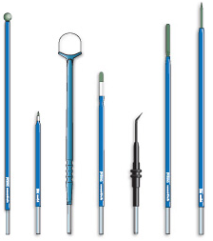
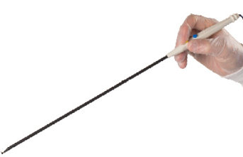
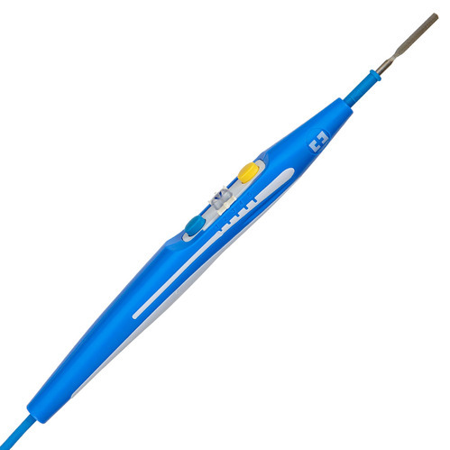
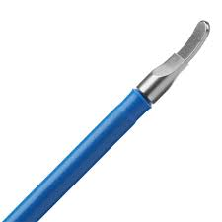
Project Changes: Scope
Open Surgery
Minimally Invasive Surgery
Notes:
I’ll start with changes that we made to our project, beginning with our project scope. Originally, our client presented us with problems he’s noticed while using electrosurgical pencils in minimally invasive surgery – mainly he talked about limited vision and lack of tactile feedback. However, the pencils we based many of our initial specifications on were actually the ones used in open surgery. There are still electrosurgical pencils used in minimally invasive surgery, but they are quite a bit longer, and feel much less like the pencil we portrayed initially. So we have broadened our project scope to include the whole range of electrosurgical tools used in minimally invasive surgery – for example: the L hook, and spatula shown on the right.

Slide 3
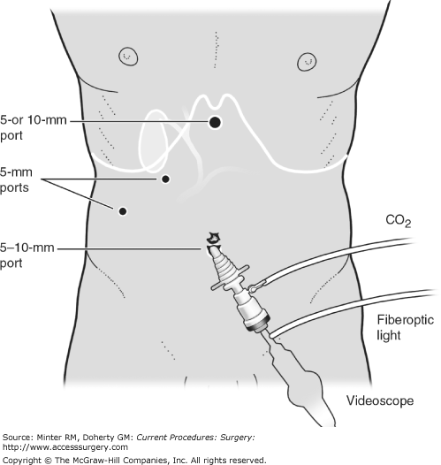
Project Changes: Design Specifications
 | Original Metric | Adjusted Metric
Size | 1.5 cm diameter 18 cm length | 10 mm diameter
Weight | 1 oz | ES attachment: <=5 oz Other: <=2.5 kg
Output | Auditory | Visual preferred, Auditory acceptable
Cost | < $6,000 | < $2,000
Time Limitation | N/A | < 4 months
Notes:
In addition, we have removed the requirement that the device must attach to an electrosurgical tool. In laparoscopic surgery, surgeons place several ports for instruments – and the device we create could be placed into any one of those ports to provide vessel location feedback. Because of this change, we adjusted many of our design specifications.

Slide 4
Project Changes: Design Specifications
 | Original Metric | Adjusted Metric
Size | 1.5 cm diameter 18 cm length | 10 mm diameter
Weight | 1 oz | ES attachment: <=5 oz Other: <=2.5 kg
Output | Auditory | Visual preferred, Auditory acceptable
Cost | < $6,000 | < $2,000
Time Limitation | N/A | < 4 months
Notes:
Our original metrics for size and weight were based on the electrosurgical pencils used in open surgery, so we have adjusted them to reflect our broadened project scope – requiring that our device fit inside the trocars used in minimally invasive surgery and have weight comparable to that of a laparoscope.

Slide 5
Project Changes: Design Specifications
 | Original Metric | Adjusted Metric
Size | 1.5 cm diameter 18 cm length | 10 mm diameter
Weight | 1 oz | ES attachment: <=5 oz Other: <=2.5 kg
Output | Auditory | Visual preferred, Auditory acceptable
Cost | < $6,000 | < $2,000
Time Limitation | N/A | < 4 months
Notes:
Also, after feedback from our previous presentation, and consulting with our client, we have determined that a visual output would provide greater three-dimensional information for localizing blood vessels – and have designated this as our preferred output. However, Dr. Chen has said that an auditory output that distinguishes between blood vessels to the right, left, up, and down, through beep speed or pitch would also be useful.

Slide 6
Project Changes: Design Specifications
 | Original Metric | Adjusted Metric
Size | 1.5 cm diameter 18 cm length | 10 mm diameter
Weight | 1 oz | ES attachment: <=5 oz Other: <=2.5 kg
Output | Auditory | Visual preferred, Auditory acceptable
Cost | < $6,000 | < $2,000
Time Limitation | N/A | < 4 months
Notes:
Next, based on feedback from several professors in the imaging field and our own continued research, we have reduced our cost metric from $6,000 to $2,000.

Slide 7
Project Changes: Design Specifications
 | Original Metric | Adjusted Metric
Size | 1.5 cm diameter 18 cm length | 10 mm diameter
Weight | 1 oz | ES attachment: <=5 oz Other: <=2.5 kg
Output | Auditory | Visual preferred, Auditory acceptable
Cost | < $6,000 | < $2,000
Time Limitation | N/A | < 4 months
Notes:
Finally, and probably most importantly, we have added a feasibility consideration in the form of time limitation. Because we have less than 4 months to complete this project, the resources we find will play a large role in the success of our final product.

Slide 8
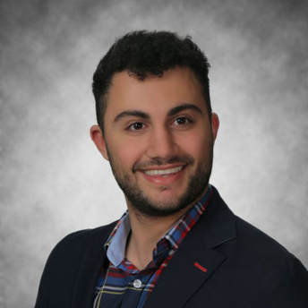
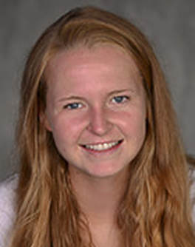
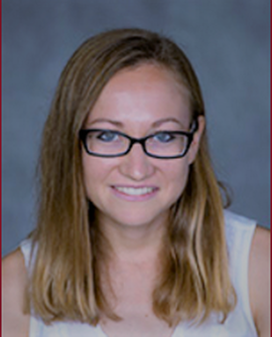
Project Changes: Team Responsibilities
 | Nima Shem | Paige Cloonan | Carly Krull
Contributions | Purchase parts Lead hardware development Create and print parts using CAD Assist with website management Write weekly reports | Lead image processing Design testing methods for the device Manage website Coordinate meetings with Dr. Chen Create and print parts using CAD Write weekly reports | Verification and Validation independent study
Notes:
The last changes we made were for our team responsibilities.
I will be finishing up at home next semester through an independent study focusing on verification and validation. Unfortunately, this means the remaining responsibilities are divided between Paige and Nima. Highlighting the most important ones: Paige has volunteered to lead image processing and the design of testing methods for our device. And Nima has agreed to purchase parts and take the lead on hardware development.

Slide 9
Specifications for Design Evaluation
Design Specification | Metric | Weight
Spatial Resolution | <= 1 mm | 9
Depth Detection Range | 1-5 mm | 9
Power Output | ES attachment: <=120 W Other: <= 720 mW/cm² | N/A
Temporal Resolution | 1 Hz | N/A
Weight | ES attachment < 5 oz Other: <= 2.5 kg | 5
Size | <= 10 mm diameter | 3
Cost | <= $2000 | 9
Time Limitation | < 4 months | 10
Output Signal | Auditory (5) or Visual (6) | 4**
Notes:
Moving into design evaluation, we identified 9 different design possibilities, and decided on 9 specifications to help us select the best approach. For spatial resolution, we chose a metric of <= 1mm, and for depth detection range, a metric of 1-5 mm. These specifications are critical to the effectiveness of our vessel detector, so we have given them a weight of 9.

Slide 10
Specifications for Design Evaluation
Design Specification | Metric | Weight
Spatial Resolution | <= 1 mm | 9
Depth Detection Range | 1-5 mm | 9
Power Output | ES attachment: <=120 W Other: <= 720 mW/cm² | N/A
Temporal Resolution | 1 Hz | N/A
Weight | ES attachment < 5 oz Other: <= 2.5 kg | 5
Size | <= 10 mm diameter | 3
Cost | <= $2000 | 9
Time Limitation | < 4 months | 10
Output Signal | Auditory (5) or Visual (6) | 4**
Notes:
For power output, if we were to create an electrosurgical attachment, the power output would be less than 120 W, which corresponds to the lowest setting for an electrosurgical device. For any other design we are referring to the FDA regulation guidelines for ultrasound devices – which require a power output of <= 720 mW/cm2. Because power output is a safety concern, we did not include it in our Pugh Chart analysis, and only technologies that met the specification were considered.

Slide 11
Specifications for Design Evaluation
Design Specification | Metric | Weight
Spatial Resolution | <= 1 mm | 9
Depth Detection Range | 1-5 mm | 9
Power Output | ES attachment: <=120 W Other: <= 720 mW/cm² | N/A
Temporal Resolution | 1 Hz | N/A
Weight | ES attachment < 5 oz Other: <= 2.5 kg | 5
Size | <= 10 mm diameter | 3
Cost | <= $2000 | 9
Time Limitation | < 4 months | 10
Output Signal | Auditory (5) or Visual (6) | 4**
Notes:
Next, we decided on a temporal resolution of 1 Hz to enable real-time feedback. All technologies we researched met this specification, so temporal resolution also was not included in the analysis.

Slide 12
Specifications for Design Evaluation
Design Specification | Metric | Weight
Spatial Resolution | <= 1 mm | 9
Depth Detection Range | 1-5 mm | 9
Power Output | ES attachment: <=120 W Other: <= 720 mW/cm² | N/A
Temporal Resolution | 1 Hz | N/A
Weight | ES attachment < 5 oz Other: <= 2.5 kg | 5
Size | <= 10 mm diameter | 3
Cost | <= $2000 | 9
Time Limitation | < 4 months | 10
Output Signal | Auditory (5) or Visual (6) | 4**
Notes:
The last 5 metrics I mentioned previously, but I do want to explain the reasoning for our weights. We assigned the weight of our device an importance of 5 because while weight is an important consideration, it is not essential to the function of a vessel detector.

Slide 13
Specifications for Design Evaluation
Design Specification | Metric | Weight
Spatial Resolution | <= 1 mm | 9
Depth Detection Range | 1-5 mm | 9
Power Output | ES attachment: <=120 W Other: <= 720 mW/cm² | N/A
Temporal Resolution | 1 Hz | N/A
Weight | ES attachment < 5 oz Other: <= 2.5 kg | 5
Size | <= 10 mm diameter | 3
Cost | <= $2000 | 9
Time Limitation | < 4 months | 10
Output Signal | Auditory (5) or Visual (6) | 4**
Notes:
We assigned size a weight of 3 because our client is primarily looking for proof of concept, and if necessary, will accept a larger working vessel detector that can be later scaled down.

Slide 14
Specifications for Design Evaluation
Design Specification | Metric | Weight
Spatial Resolution | <= 1 mm | 9
Depth Detection Range | 1-5 mm | 9
Power Output | ES attachment: <=120 W Other: <= 720 mW/cm² | N/A
Temporal Resolution | 1 Hz | N/A
Weight | ES attachment < 5 oz Other: <= 2.5 kg | 5
Size | <= 10 mm diameter | 3
Cost | <= $2000 | 9
Time Limitation | < 4 months | 10
Output Signal | Auditory (5) or Visual (6) | 4**
Notes:
For cost, we assigned a weight of 9 because many of the technologies we researched were fairly costly, and we do have a budget.

Slide 15
Specifications for Design Evaluation
Design Specification | Metric | Weight
Spatial Resolution | <= 1 mm | 9
Depth Detection Range | 1-5 mm | 9
Power Output | ES attachment: <=120 W Other: <= 720 mW/cm² | N/A
Temporal Resolution | 1 Hz | N/A
Weight | ES attachment < 5 oz Other: <= 2.5 kg | 5
Size | <= 10 mm diameter | 3
Cost | <= $2000 | 9
Time Limitation | < 4 months | 10
Output Signal | Auditory (5) or Visual (6) | 4**
Notes:
The time limitation specification serves as our feasibility check, so we have given that spec a weight of 10.

Slide 16
Specifications for Design Evaluation
Design Specification | Metric | Weight
Spatial Resolution | <= 1 mm | 9
Depth Detection Range | 1-5 mm | 9
Power Output | ES attachment: <=120 W Other: <= 720 mW/cm² | N/A
Temporal Resolution | 1 Hz | N/A
Weight | ES attachment < 5 oz Other: <= 2.5 kg | 5
Size | <= 10 mm diameter | 3
Cost | <= $2000 | 9
Time Limitation | < 4 months | 10
Output Signal | Auditory (5) or Visual (6) | 4**
Notes:
And finally, we have created a special scoring system for output signal. Because our client has chosen to accept either an auditory or visual signal, we have given this spec a weight of 4. However, because visual outputs are inherently more useful, they receive a score of 6, while designs with auditory outputs receive a 5. Neither type of output will receive a 10 because the outputs we are considering will not provide the best solution.

Slide 17
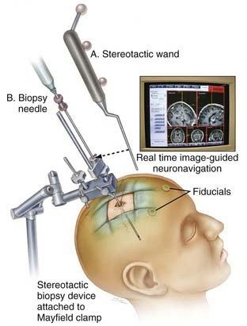
The Ideal Solution: Laser Range Scanning
Notes:
We think that the best solution is laser range scanning. This technology has been used in brain surgery to map a patient’s CT or MRI scans to the surface of the head and to surgical instruments.
In this way, surgeons can see where they are in the patient’s brain in real time.
This technique uses fiducials on the scalp to map the patient’s exterior to their interior.
The major problem with bringing this technology to general surgery is that the brain remains approximately stationary and undeformed inside the skull, while organs shift and deform inside the abdomen.
This makes it difficult to do mapping in the abdomen, but one doctor we spoke with had been successful in bringing this technology to his liver surgeries.

Slide 18
The Ideal Solution: Laser Range Scanning
Notes:
These three images show different sections of a patient’s CT scan overlaid on her liver. The surgeon used this technology successfully to localize and remove a cancerous lesion. However, laser range scanning will require a lot of coding and calibration to map 2D image sections to 3D space. Without sufficient resources, and because we are undergrads, this solution did not receive the best score on our Pugh Chart. We chose to include it primarily for completeness.

Slide 19
Design Analysis
Concept Selection: 1 = bad, 10 = good Key Criteria | Criteria Weight | Laser/Photoacoustic | Laser Doppler Flowmetry | Coherence Gated Doppler | Impedance-Based Vessel Detector | ICG | Impedance Tomography | Laser Range Scanner | Ultrasound Doppler | Spatial Frequency Domain Imaging
Spatial Resolution (<=1mm) | 9 | 63 | 90 | 90 | 9 | 36 | 63 | 90 | 54 | 90
Depth Detection (max) <5mm | 9 | 27 | 45 | 90 | 9 | 9 | 72 | 90 | 90 | 72
Size (10mm) | 3 | 24 | 30 | 30 | 30 | 30 | 30 | 21 | 18 | 6
Cost (<$2,000) | 9 | 63 | 18 | 18 | 90 | 27 | 9 | 9 | 90 | 63
Output (warning = 5, visual = 6, w/ mapping= 10) | 4 | 20 | 20 | 20 | 20 | 24 | 24 | 40 | 20 | 24
Time Limitation (<4 months) | 10 | 10 | 10 | 10 | 60 | 70 | 40 | 10 | 60 | 70
Weight (pencil <4 oz, else <2.5kg) | 5 | 45 | 45 | 45 | 50 | 50 | 50 | 50 | 35 | 35
 | Total Score | 252 | 258 | 303 | 268 | 246 | 288 | 310 | 367 | 360

Slide 20
Design Analysis
Concept Selection: 1 = bad, 10 = good Key Criteria | Criteria Weight | Laser/Photoacoustic | Laser Doppler Flowmetry | Coherence Gated Doppler | Impedance-Based Vessel Detector | ICG | Impedance Tomography | Laser Range Scanner | Ultrasound Doppler | Spatial Frequency Domain Imaging
Spatial Resolution (<=1mm) | 9 | 63 | 90 | 90 | 9 | 36 | 63 | 90 | 54 | 90
Depth Detection (max) <5mm | 9 | 27 | 45 | 90 | 9 | 9 | 72 | 90 | 90 | 72
Size (10mm) | 3 | 24 | 30 | 30 | 30 | 30 | 30 | 21 | 18 | 6
Cost (<$2,000) | 9 | 63 | 18 | 18 | 90 | 27 | 9 | 9 | 90 | 63
Output (warning = 5, visual = 6, w/ mapping= 10) | 4 | 20 | 20 | 20 | 20 | 24 | 24 | 40 | 20 | 24
Time Limitation (<4 months) | 10 | 10 | 10 | 10 | 60 | 70 | 40 | 10 | 60 | 70
Weight (pencil <4 oz, else <2.5kg) | 5 | 45 | 45 | 45 | 50 | 50 | 50 | 50 | 35 | 35
 | Total Score | 252 | 258 | 303 | 268 | 246 | 288 | 310 | 367 | 360

Slide 21
Design Analysis
Concept Selection: 1 = bad, 10 = good Key Criteria | Criteria Weight | Laser/Photoacoustic | Laser Doppler Flowmetry | Coherence Gated Doppler | Impedance-Based Vessel Detector | ICG | Impedance Tomography | Laser Range Scanner | Ultrasound Doppler | Spatial Frequency Domain Imaging
Spatial Resolution (<=1mm) | 9 | 63 | 90 | 90 | 9 | 36 | 63 | 90 | 54 | 90
Depth Detection (max) <5mm | 9 | 27 | 45 | 90 | 9 | 9 | 72 | 90 | 90 | 72
Size (10mm) | 3 | 24 | 30 | 30 | 30 | 30 | 30 | 21 | 18 | 6
Cost (<$2,000) | 9 | 63 | 18 | 18 | 90 | 27 | 9 | 9 | 90 | 63
Output (warning = 5, visual = 6, w/ mapping= 10) | 4 | 20 | 20 | 20 | 20 | 24 | 24 | 40 | 20 | 24
Time Limitation (<4 months) | 10 | 10 | 10 | 10 | 60 | 70 | 40 | 10 | 60 | 70
Weight (pencil <4 oz, else <2.5kg) | 5 | 45 | 45 | 45 | 50 | 50 | 50 | 50 | 35 | 35
 | Total Score | 252 | 258 | 303 | 268 | 246 | 288 | 310 | 367 | 360

Slide 22
Design Analysis
Concept Selection: 1 = bad, 10 = good Key Criteria | Criteria Weight | Laser/Photoacoustic | Laser Doppler Flowmetry | Coherence Gated Doppler | Impedance-Based Vessel Detector | ICG | Impedance Tomography | Laser Range Scanner | Ultrasound Doppler | Spatial Frequency Domain Imaging
Spatial Resolution (<=1mm) | 9 | 63 | 90 | 90 | 9 | 36 | 63 | 90 | 54 | 90
Depth Detection (max) <5mm | 9 | 27 | 45 | 90 | 9 | 9 | 72 | 90 | 90 | 72
Size (10mm) | 3 | 24 | 30 | 30 | 30 | 30 | 30 | 21 | 18 | 6
Cost (<$2,000) | 9 | 63 | 18 | 18 | 90 | 27 | 9 | 9 | 90 | 63
Output (warning = 5, visual = 6, w/ mapping= 10) | 4 | 20 | 20 | 20 | 20 | 24 | 24 | 40 | 20 | 24
Time Limitation (<4 months) | 10 | 10 | 10 | 10 | 60 | 70 | 40 | 10 | 60 | 70
Weight (pencil <4 oz, else <2.5kg) | 5 | 45 | 45 | 45 | 50 | 50 | 50 | 50 | 35 | 35
 | Total Score | 252 | 258 | 303 | 268 | 246 | 288 | 310 | 367 | 360

Slide 23
Design Analysis
Concept Selection: 1 = bad, 10 = good Key Criteria | Criteria Weight | Laser/Photoacoustic | Laser Doppler Flowmetry | Coherence Gated Doppler | Impedance-Based Vessel Detector | ICG | Impedance Tomography | Laser Range Scanner | Ultrasound Doppler | Spatial Frequency Domain Imaging
Spatial Resolution (<=1mm) | 9 | 63 | 90 | 90 | 9 | 36 | 63 | 90 | 54 | 90
Depth Detection (max) <5mm | 9 | 27 | 45 | 90 | 9 | 9 | 72 | 90 | 90 | 72
Size (10mm) | 3 | 24 | 30 | 30 | 30 | 30 | 30 | 21 | 18 | 6
Cost (<$2,000) | 9 | 63 | 18 | 18 | 90 | 27 | 9 | 9 | 90 | 63
Output (warning = 5, visual = 6, w/ mapping= 10) | 4 | 20 | 20 | 20 | 20 | 24 | 24 | 40 | 20 | 24
Time Limitation (<4 months) | 10 | 10 | 10 | 10 | 60 | 70 | 40 | 10 | 60 | 70
Weight (pencil <4 oz, else <2.5kg) | 5 | 45 | 45 | 45 | 50 | 50 | 50 | 50 | 35 | 35
 | Total Score | 252 | 258 | 303 | 268 | 246 | 288 | 310 | 367 | 360

Slide 24
Design Analysis
Concept Selection: 1 = bad, 10 = good Key Criteria | Criteria Weight | Laser/Photoacoustic | Laser Doppler Flowmetry | Coherence Gated Doppler | Impedance-Based Vessel Detector | ICG | Impedance Tomography | Laser Range Scanner | Ultrasound Doppler | Spatial Frequency Domain Imaging
Spatial Resolution (<=1mm) | 9 | 63 | 90 | 90 | 9 | 36 | 63 | 90 | 54 | 90
Depth Detection (max) <5mm | 9 | 27 | 45 | 90 | 9 | 9 | 72 | 90 | 90 | 72
Size (10mm) | 3 | 24 | 30 | 30 | 30 | 30 | 30 | 21 | 18 | 6
Cost (<$2,000) | 9 | 63 | 18 | 18 | 90 | 27 | 9 | 9 | 90 | 63
Output (warning = 5, visual = 6, w/ mapping= 10) | 4 | 20 | 20 | 20 | 20 | 24 | 24 | 40 | 20 | 24
Time Limitation (<4 months) | 10 | 10 | 10 | 10 | 60 | 70 | 40 | 10 | 60 | 70
Weight (pencil <4 oz, else <2.5kg) | 5 | 45 | 45 | 45 | 50 | 50 | 50 | 50 | 35 | 35
 | Total Score | 252 | 258 | 303 | 268 | 246 | 288 | 310 | 367 | 360

Slide 25
Design Analysis
Concept Selection: 1 = bad, 10 = good Key Criteria | Criteria Weight | Laser/Photoacoustic | Laser Doppler Flowmetry | Coherence Gated Doppler | Impedance-Based Vessel Detector | ICG | Impedance Tomography | Laser Range Scanner | Ultrasound Doppler | Spatial Frequency Domain Imaging
Spatial Resolution (<=1mm) | 9 | 63 | 90 | 90 | 9 | 36 | 63 | 90 | 54 | 90
Depth Detection (max) <5mm | 9 | 27 | 45 | 90 | 9 | 9 | 72 | 90 | 90 | 72
Size (10mm) | 3 | 24 | 30 | 30 | 30 | 30 | 30 | 21 | 18 | 6
Cost (<$2,000) | 9 | 63 | 18 | 18 | 90 | 27 | 9 | 9 | 90 | 63
Output (warning = 5, visual = 6, w/ mapping= 10) | 4 | 20 | 20 | 20 | 20 | 24 | 24 | 40 | 20 | 24
Time Limitation (<4 months) | 10 | 10 | 10 | 10 | 60 | 70 | 40 | 10 | 60 | 70
Weight (pencil <4 oz, else <2.5kg) | 5 | 45 | 45 | 45 | 50 | 50 | 50 | 50 | 35 | 35
 | Total Score | 252 | 258 | 303 | 268 | 246 | 288 | 310 | 367 | 360

Slide 26
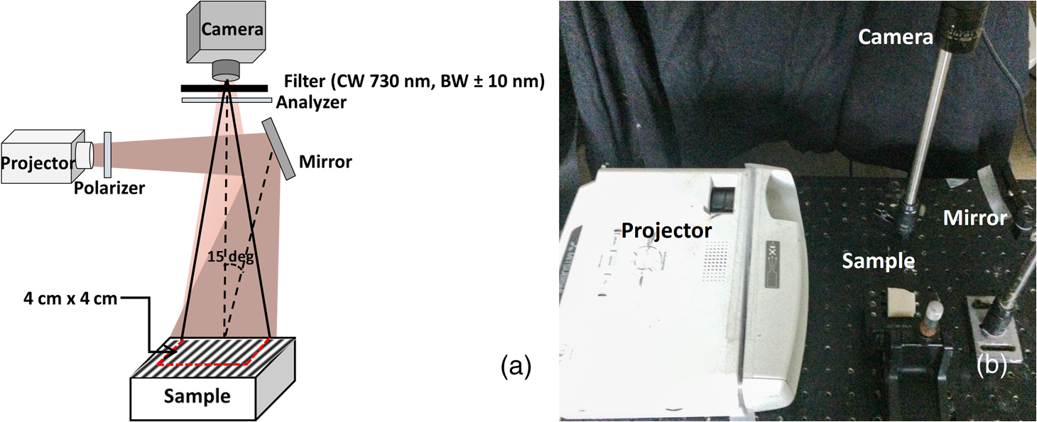
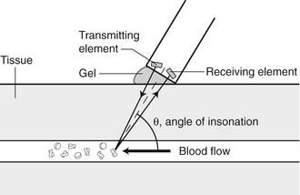
Design Evaluation
Score: 367
Score: 360
Doppler Ultrasound
Spatial Frequency Domain Imaging
Notes:
The two highest-scoring designs in our evaluation were Doppler ultrasound and spatial frequency domain imaging, both of which received at least 50 points more than the other designs. Doppler ultrasound came in slightly ahead of spatial frequency domain imaging, primarily because of its low cost, feasibility, and detection versatility. Spatial frequency domain imaging received fewer points mostly due to its size.

Slide 27
Design Evaluation
Score: 367
Score: 360
Doppler Ultrasound
Spatial Frequency Domain Imaging
Notes:
Despite the slightly lower score, we have chosen SFDI as the design for our device. This decision is two-fold. Firstly Dr. Chen was particularly concerned about the direct contact required when using Doppler ultrasound, which can result in occluding blood vessels near the surface. This could considerably reduce the effectiveness of an ultrasound probe. Secondly, we reached out to Dr. Zhu here at WashU, and several members in her lab that have worked with spatial frequency domain imaging have agreed to mentor us in the design of our device.

Slide 28
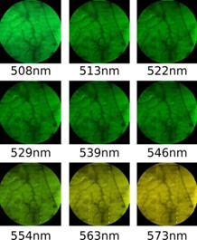
Chosen Solution: Spatial Frequency Domain Imaging
Advantages | Disadvantages
Spatial Resolution: .33 mm | Size: 5 cm projector head
Depth Detection: 1-3 mm | Output Signal: Visual, no mapping
Cost: < $2000
Time: Mentors Available
Notes:
A little bit about spatial frequency domain imaging. This technology works by shining different patterns of light on tissue, and using the reflected light to quantify the number of chromophores. In this way, blood vessels can be distinguished from surrounding tissue, as shown on the left.

Slide 29
Chosen Solution: Spatial Frequency Domain Imaging
Advantages | Disadvantages
Spatial Resolution: .33 mm | Size: 5 cm projector head
Depth Detection: 1-3 mm | Output Signal: Visual, no mapping
Cost: < $2000
Time: Mentors Available
Notes:
The functional advantages for spatial frequency domain imaging are its spatial resolution and depth detection capabilities. The researchers we spoke with confirmed that a system could be built and tested for less than $2,000, and their willingness to mentor our group makes this a feasible project in the time we have.

Slide 30
Chosen Solution: Spatial Frequency Domain Imaging
Advantages | Disadvantages
Spatial Resolution: .33 mm | Size: 5 cm projector head
Depth Detection: 1-3 mm | Output Signal: Visual, no mapping
Cost: < $2000
Time: Mentors Available
Notes:
The major disadvantage for this technology is the size – which is currently 5 cm in diameter, but our goals moving forward include integrating with laparoscopes and making a smaller system. Finally, we are aware that this is likely not the ideal solution, because we will not map the blood vessel image to anatomy in the body.

Slide 31
Budget: $350
Item | Quantity | Unit Price | Total Price | Source
MILALOKO Mini Wi-Fi Small Wireless Camera | 1 | $52.99 | $52.99 | Amazon
Polarized Filter Slide | 3 | $8.99 | $26.97 | Amazon
Small Mirror | 3 | $2.99 | $8.97 | Amazon
Mini Projector | 1 | $44.99 | $44.99 | Amazon
Jell-O | 4 | $1.02 | $4.08 | Amazon
Straws | 1 | $4.57 | $4.57 | Amazon
Food Dye | 1 | $2.69 | $2.69 | Amazon
Pork Shoulder | 5 | $3.00 per lb | $15.00 | Sam’s Club
 |  | Total | $160.26
Phantom tissue
Phantom vessel
Notes:
To maker our SFDI system we’re planning to buy a small camera, several polarizers and mirrors, and a projector. For testing we’re looking at using Jello-O, straws, food dye, and pork shoulder. Based on prices we found online, the total would come to about $160. However, we do expect to make some iterations of the design in order to optimize size and vessel detection – so we are asking the department for $350.

Slide 32
References
Cash, David M. et al. “Incorporation of a Laser Range Scanner into Image-Guided Liver Surgery: Surface Acquisition, Registration, and Tracking.” Medical physics 30.7 (2003): 1671–1682. Print.
“Frame and Frameless Stereotactic Brain Biopsy.” Clinical Gate, 26 Mar. 2015, clinicalgate.com/frame-and-frameless-stereotactic-brain-biopsy/#f0020.
Themes, UFO. “Doppler Ultrasound.” Radiology Key, 26 Dec. 2015, radiologykey.com/doppler-ultrasound-2/.
Robert T. Kester, Noah Bedard, Liang S. Gao, Tomasz S. Tkaczyk, "Real-time snapshot hyperspectral imaging endoscope," Journal of Biomedical Optics 16(5), 056005 (1 May 2011).
S. Nandy, A. Mostafa, p. kumavor, and Q. Zhu, "Application of spatial frequency domain imaging for characterizing wide field tissue optical heterogeneity," in Biomedical Optics 2016, OSA Technical Digest (online) (Optical Society of America, 2016), paper JM3A.1.
Sordillo, Laura & Pu, Yang & Pratavieira, Sebastião & Budansky, Yury & Alfano, Robert. (2014). Deep optical imaging of tissue using the second and third near-infrared spectral windows. Journal of biomedical optics. 19. 56004. 10.1117/1.JBO.19.5.056004.
Notes:
And that’s it. Thank you.

Slide 33
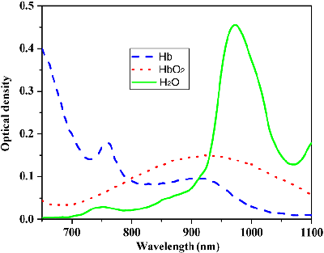
SFDI

